Slide 1

Commercialization strategy for a new technology in a highly dynamic market environment
CHEMICALS & AGRICULTURE (GEM) | WESTERN EUROPE
CHA001
Commercialization strategy for a new technology in the electric vehicle market – a highly dynamic and uncertain market environment. Starting with an assessment of the overall market potential, including a detailed market model and a perspective on the technology landscape, we assessed the value chain dynamics and its implications on potential market entry moves for the client.
Based on that, we developed concrete sets of actions to the client for a successful market entry along 3 core dimensions: customer, product, and operating model. Our work formed the basis for the largest investment decision taken in the 150-year history of the company.
Our efforts were consistently cross-functional and strongly supported by M&S functional leadership and expert practitioners.
NOTE: PLEASE DO NOT SHARE EXTERNALLY WITHOUT CST APPROVAL

Slide 2
Commercialization strategy: Creating a new business in a highly dynamic market environment
CHEMICALS & AGRICULTURE (GEM) | WESTERN EUROPE
CHA001
Growth
Actions
Invest
Prepared fundamental decision on investment into new business model, incl. market modelling and value chain analysis
> 10% ROIC
Develop
Developed comprehensive customer map with clear priority targets
Identified key milestones and "trigger points" to reach competitive product for market readiness
Prepared roadmap to build up a scalable operating model
Scale up
Modelled 3 market evolution scenarios to identify potential growth opportunities in the mid- and long-term
Prepared "decision map" along core elements (customer, product, operating model) to effectively scale new business within potential market scenarios
Up to ~ €1 billion/ year on scalable business model

Slide 3
Case study: Commercialization strategy for a new technology in a highly dynamic and uncertain market environment
CHEMICALS & AGRICULTURE (GEM) | WESTERN EUROPE
CHA001
Client context
Approach
Impact
Client acquired and further developed new technology in the field of electric vehicles, a market in which the organization only has limited knowledge and experience
Needed support in bringing in external knowledge and expertise both in the specific market context as well as in the creation of successful commercialization strategies under uncertainty
Goal was to evaluate the market opportunity for this technology as well as concrete steps for the go-to-market approach as a basis for the largest investment decision taken in the 150-year tradition of the company
3-week "DD-like" development of quantitative market model and evolution scenarios – using both client and firm knowledge and data – as well as qualitative assessment of current value chain and value chain dynamics
3-week phase on assessing relevant implications and developing potential market entry strategies under uncertainty and along the 3 core dimensions: customer, product, and operating model
1-week phase on synthesizing findings into concrete sets of actions and next steps to the company's Board of Directors
Enabled the client to develop a business case for a new technology that can potentially become one of their largest profit contributors in the future
Where is the impact opportunity …
Highly dynamic and uncertain markets provide investment opportunities for a large set of existing and new players
Our approach provides potential clients with the relevant expertise, knowledge and data needed to develop a successful commercialization strategy for new technologies – particularly for, but not limited to, the automotive industry
Through that, clients can gain access to large value pools outside their traditional business model
Client name: CLIENT (Needed just for admin tracking purpose and will be kept confidential)
Team set-up: EM+2
Fees Structure: Fixed
What was unique: We combined the best of the firm's knowledge and resources from 3 different practices: Marketing & Sales, Automotive, and Strategy – an unmatched value proposition to the client

Slide 4

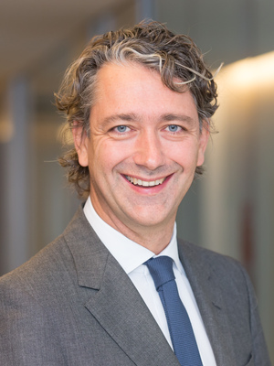
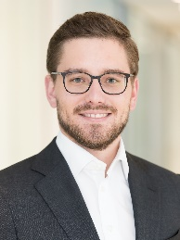
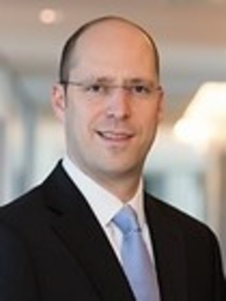

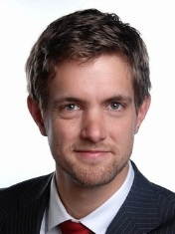



Our team
Leadership team
Full-time working team
Dedicated expert support
Michael Birshan Senior Partner
Strategy development
Dieter Kiewell Senior Partner Marketing & Sales
Jonas Augustin Project lead, industry expert
Martin Linder Partner with extensive OEM, supplier and battery expertise
Eric Hannon Lead Partner specialised in electrification of mobility
Markus Wilthaner Strategic project lead, specialised in batteries
Leonie Vogt Consultant with deep technical battery expertise
Thomas Schuldt
Consultant with expertise in batteries and go-to-market strategies
Kyungyeol Song Lead of McKinsey Energy Center and expert for battery materials

